Slide 1
CHAPTER 3 (Part 2)
Data Storage

Slide 2
Objectives
After studying this chapter, the student should be able to:
List five different data types used in a computer.
Describe how different data is stored inside a computer.
Describe how integers are stored in a computer.
Describe how reals are stored in a computer.
Describe how text is stored in a computer using one of the various encoding systems.
Describe how audio is stored in a computer using sampling, quantization, and encoding.
Describe how images are stored in a computer using raster and vector graphics schemes.
Describe how video is stored in a computer as a representation of images changing in time.
3.2

Slide 3

Storing reals
A real is a number with an integral part and a fractional part. For example, 23.7 is a real number—the integral part is 27 and the fractional part is 7/10. Although a fixed-point representation can be used to represent a real number, the result may not be accurate or it may not have the required precision. The next two examples explain why.
i
Real numbers with very large integral parts or very small fractional parts should not be stored in fixed-point representation.

Slide 4
Example 3.16
In the decimal system, assume that we use a fixed-point representation with two digits at the right of the decimal point and fourteen digits at the left of the decimal point, for a total of sixteen digits. The precision of a real number in this system is lost if we try to represent a decimal number such as 1.00234: the system stores the number as 1.00.
Example 3.17
In the decimal system, assume that we use a fixed-point representation with six digits to the right of the decimal point and ten digits for the left of the decimal point, for a total of sixteen digits. The accuracy of a real number in this system is lost if we try to represent a decimal number such as 236154302345.00. The system stores the number as 6154302345.00: the integral part is much smaller than it should be.

Slide 5

Floating-point representation
The solution for maintaining accuracy or precision is to use floating-point representation.
Figure 3.10 The three parts of a real number in floating-point
i
A floating point representation of a number is made up of three parts: a sign, a shifter, and a fixed-point number.

Slide 6
Example 3.18
The following shows the decimal number
7,452,000,000,000,000,000,000.00
in scientific notation (floating-point representation).
The three sections are the sign (+), the shifter (21), and the fixed-point part (7.425). Note that the shifter is the exponent.

Slide 7
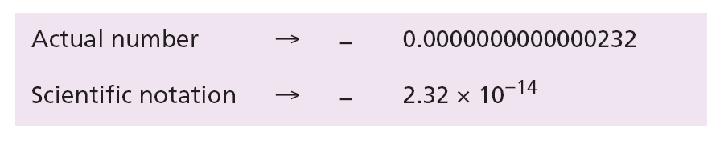
Example 3.19
Show the number
−0.0000000000000232
in scientific notation (floating-point representation).
Solution We use the same approach as in the previous example—we move the decimal point after the digit 2, as shown below:
The three sections are the sign (−), the shifter (−14), and the fixed-point part (2.32). Note that the shifter is the exponent.

Slide 8
Example 3.20
Show the number
(101001000000000000000000000000000.00)₂
in floating-point representation.
Solution We use the same idea, keeping only one digit to the left of the decimal point.

Slide 9
Example 3.21
Show the number
−(0.00000000000000000000000101)₂
in floating-point representation.
Solution We use the same idea, keeping only one digit to the left of the decimal point.

Slide 10
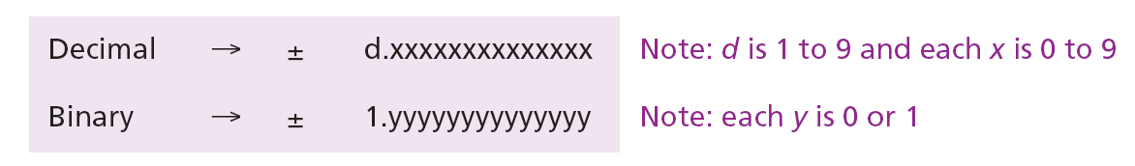
Normalization
To make the fixed part of the representation uniform, both the scientific method (for the decimal system) and the floating-point method (for the binary system) use only one non-zero digit on the left of the decimal point. This is called normalization. In the decimal system this digit can be 1 to 9, while in the binary system it can only be 1. In the following, d is a non-zero digit, x is a digit, and y is either 0 or 1.

Slide 11
i
Note that the point and the bit 1 to the left of the fixed-point section are not stored—they are implicit.
i
The mantissa is a fractional part that, together with the sign, is treated like an integer stored in sign-and-magnitude representation.

Slide 12
Excess System
The exponent, the power that shows how many bits the decimal point should be moved to the left or right, is a signed number. Although this could have been stored using two’s complement representation, a new representation, called the Excess system, is used instead. In the Excess system, both positive and negative integers are stored as unsigned integers. To represent a positive or negative integer, a positive integer (called a bias) is added to each number to shift them uniformly to the non-negative side. The value of this bias is 2^{m−1} − 1, where m is the size of the memory location to store the exponent.

Slide 13
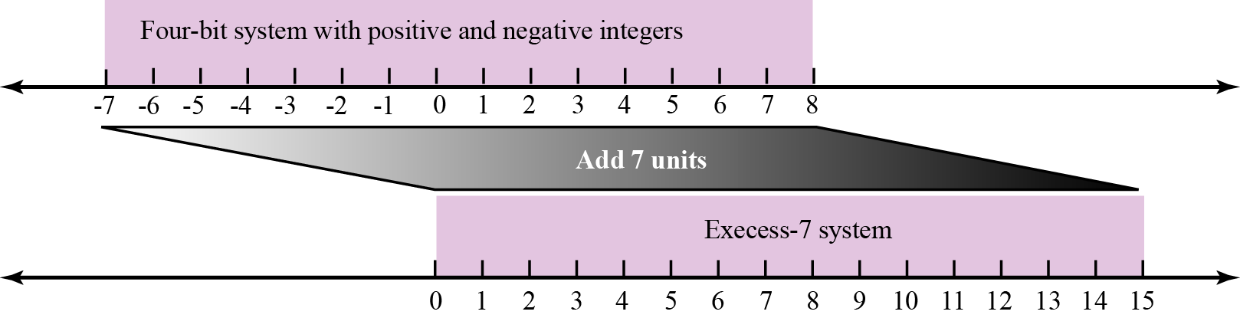
Example 3.22
We can express sixteen integers in a number system with 4-bit allocation. By adding seven units to each integer in this range, we can uniformly translate all integers to the right and make all of them positive without changing the relative position of the integers with respect to each other, as shown in the figure. The new system is referred to as Excess-7, or biased representation with biasing value of 7.
Figure 3.11 Shifting in Excess representation

Slide 14
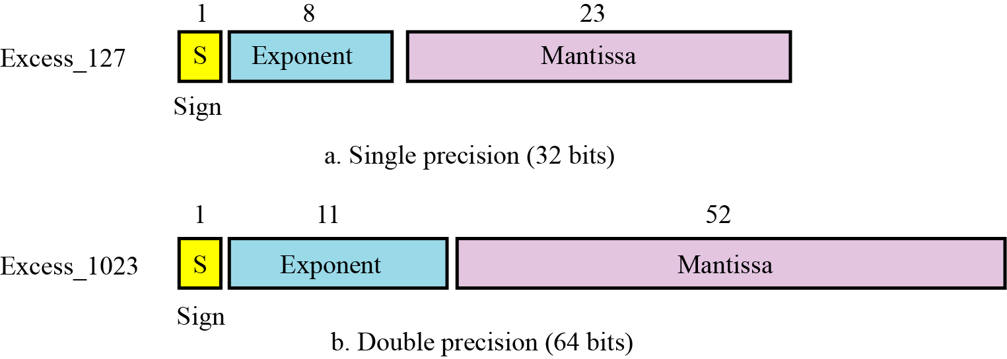
IEEE Standard
Figure 3.12 IEEE standards for floating-point representation

Slide 15
IEEE Specifications

Slide 16
Example 3.23
Show the Excess_127 (single precision) representation of the decimal number 5.75.
Solution
The sign is positive, so S = 0.
Decimal to binary transformation: 5.75 = (101.11)₂.
Normalization: (101.11)₂ = (1.1011)₂ × 2².
E = 2 + 127 = 129 = (10000001)₂, M = 1011. We need to add nineteen zeros at the right of M to make it 23 bits.
The presentation is shown below:
The number is stored in the computer as
01000000110110000000000000000000

Slide 17
Example 3.24
Show the Excess_127 (single precision) representation of the decimal number –161.875.
Solution
The sign is negative, so S = 1.
Decimal to binary transformation: 161.875= (10100001.111)₂.
Normalization: (10100001.111)₂ = (1.0100001111)₂ × 2⁷.
E = 7 + 127 = 134 = (10000110)₂ and M = (0100001111)₂.
Representation:
The number is stored in the computer as
11000011010000111100000000000000

Slide 18
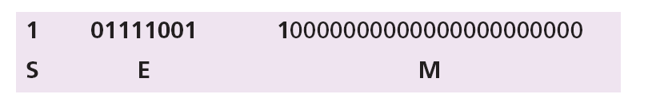
Example 3.25
Show the Excess_127 (single precision) representation of the decimal number –0.0234375.
Solution
S = 1 (the number is negative).
Decimal to binary transformation: 0.0234375 = (0.0000011)₂.
Normalization: (0.0000011)₂ = (1.1)₂ × 2⁻⁶.
E = –6 + 127 = 121 = (01111001)₂ and M = (1)₂.
Representation:
The number is stored in the computer as
10111100110000000000000000000000

Slide 19
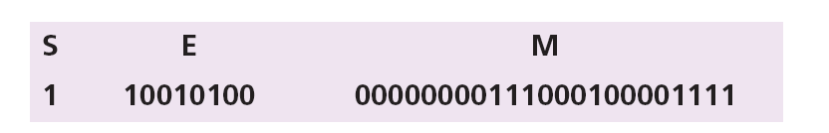
Example 3.26
The bit pattern (11001010000000000111000100001111)₂ is stored in Excess_127 format. Show the value in decimal.
Solution
The first bit represents S, the next eight bits, E and the remaining 23 bits, M.
The sign is negative.
The shifter = E − 127 = 148 − 127 = 21.
This gives us (1.00000000111000100001111)₂ × 2²¹.
The binary number is (1000000001110001000011.11)₂.
The absolute value is 2,104,378.75.
The number is −2,104,378.75.

Slide 20
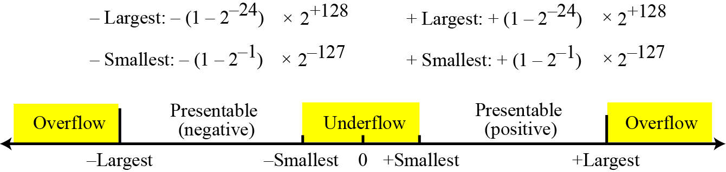
Overflow and Underflow
Figure 3.13 Overflow and underflow in reals
Storing Zero
A real number with an integral part and the fractional part set to zero, that is, 0.0, cannot be stored using the steps discussed above. To handle this special case, it is agreed that in this case the sign, exponent, and the mantissa are set to 0s.

Slide 21
3-3 STORING TEXT
A section of text in any language is a sequence of symbols used to represent an idea in that language. For example, the English language uses 26 symbols (A, B, C,…, Z) to represent uppercase letters, 26 symbols (a, b, c, …, z) to represent lowercase letters, nine symbols (0, 1, 2, …, 9) to represent numeric characters and symbols (., ?, :, ; , …, !) to represent punctuation. Other symbols such as blank, newline, and tab are used for text alignment and readability.

Slide 22
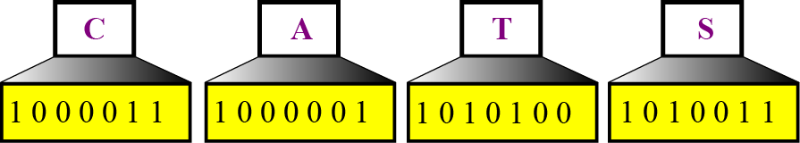
We can represent each symbol with a bit pattern. In other words, text such as “CATS”, which is made up from four symbols, can be represented as four n-bit patterns, each pattern defining a single symbol (Figure 3.14).
Figure 3.14 Representing symbols using bit patterns

Slide 23
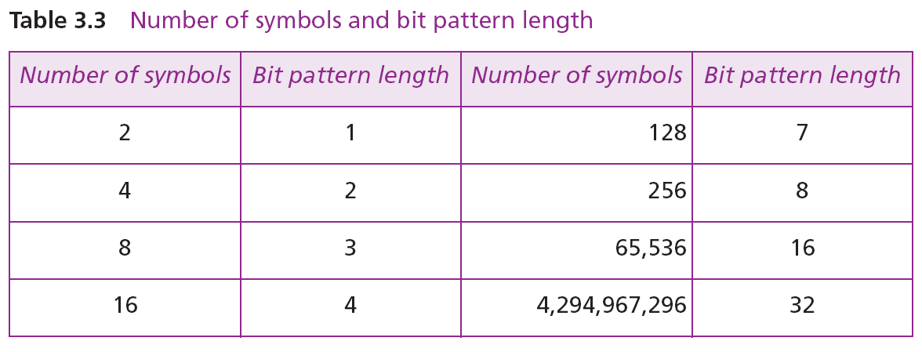

Slide 24
Codes
ASCII
Unicode
Other Codes
i
See Appendix A

Slide 25
3-4 STORING AUDIO
Audio is a representation of sound or music. Audio, by nature, is different than the numbers or text we have discussed so far. Text is composed of countable entities (characters): we can count the number of characters in text. Text is an example of digital data. In contrast, audio is not countable. Audio is an example of analog data. Even if we are able to measure all its values in a period of time, we cannot store these in the computer’s memory, as we would need infinite number of memory locations. Figure 3.15 shows the nature of an analog signal, such as audio, that varies with time.

Slide 26
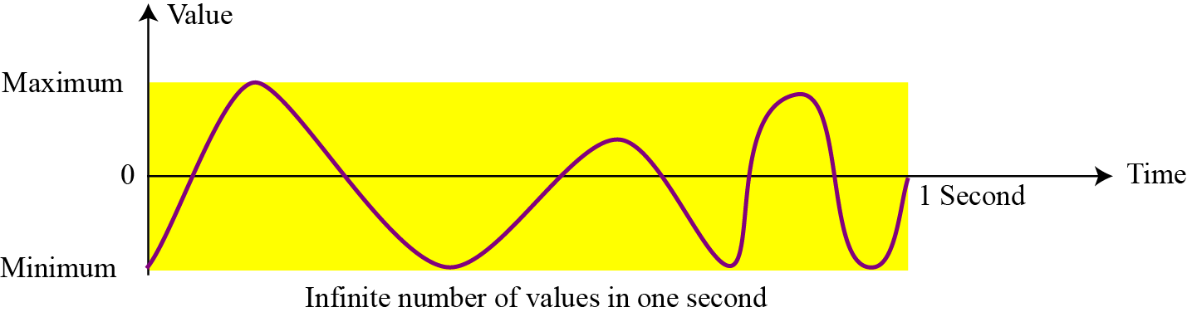
Figure 3.15 An audio signal

Slide 27
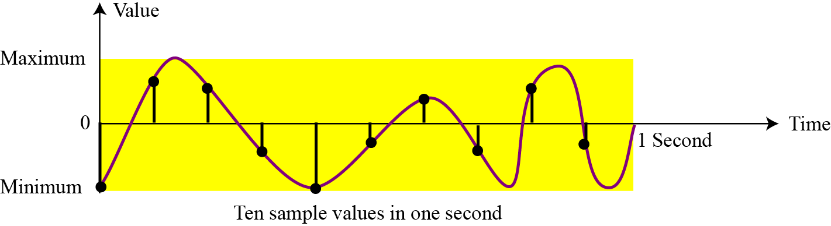
3.4.1 Sampling
If we cannot record all the values of a an audio signal over an interval, we can record some of them. Sampling means that we select only a finite number of points on the analog signal, measure their values, and record them.
Figure 3.16 Sampling an audio signal

Slide 28
3.4.2 Quantization
The value measured for each sample is a real number. This means that we can store 40,000 real values for each one second sample. However, it is simpler to use an unsigned integer (a bit pattern) for each sample. Quantization refers to a process that rounds the value of a sample to the closest integer value. For example, if the real value is 17.2, it can be rounded down to 17: if the value is 17.7, it can be rounded up to 18.

Slide 29
3.4.2 Encoding
The quantized sample values need to be encoded as bit patterns. Some systems assign positive and negative values to samples, some just shift the curve to the positive part and assign only positive values.
If we call the bit depth or number of bits per sample B, the number of samples per second, S, we need to store S × B bits for each second of audio. This product is sometimes refer to as bit rate, R. For example, if we use 40,000 samples per second and 16 bits per each sample, the bit rate is
R = 40,000 × 16 = 640,000 bits per second

Slide 30
3.4.4 Standards for sound encoding
Today the dominant standard for storing audio is MP3 (short for MPEG Layer 3). This standard is a modification of the MPEG (Motion Picture Experts Group) compression method used for video. It uses 44100 samples per second and 16 bits per sample. The result is a signal with a bit rate of 705,600 bits per second, which is compressed using a compression method that discard information that cannot be detected by the human ear. This is called lossy compression, as opposed to lossless compression: see Chapter 15.

Slide 31
3-5 STORING IMAGES
Images are stored in computers using two different techniques: raster graphics and vector graphics.
3.5.1 Raster graphics
Raster graphics (or bitmap graphics) is used when we need to store an analog image such as a photograph. A photograph consists of analog data, similarly to audio information: the difference is that the intensity (color) of data varies in space instead of in time. This means that data must be sampled. However, sampling in this case is normally called scanning. The samples are called pixels (picture elements).

Slide 32
Resolution
Just like audio sampling, in image scanning we need to decide how many pixels we need to record for each square or linear inch. The scanning rate in image processing is called resolution. If the resolution is sufficiently high, the human eye cannot recognize the discontinuity in reproduced images.
Color depth
The number of bits used to represent a pixel, its color depth, depends on how the pixel’s color is handled by different encoding techniques. The perception of color is how our eyes respond to a beam of light. Our eyes have different types of photoreceptor cells: some respond to the three primary colors red, green, and blue (often called RGB), while others merely respond to the intensity of light.

Slide 33
True-Color
One of the techniques used to encode a pixel is called True-Color, which uses 24 bits to encode a pixel.

Slide 34
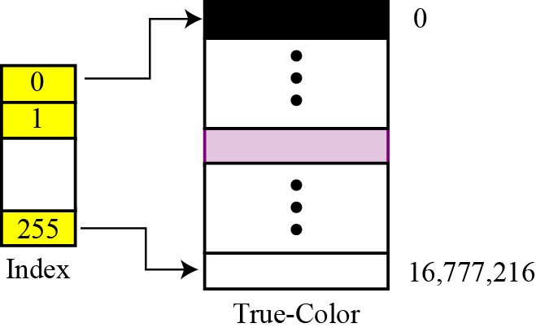
Indexed color
The indexed color—or palette color—scheme uses only a portion of these colors.
Figure 3.17 Relationship of the indexed color to the True-Color

Slide 35
For example, a high-quality digital camera uses almost three million pixels for a 3 × 5 inch photo. The following shows the number of bits that need to be stored using each scheme:

Slide 36
Standards for image encoding
Several de facto standards for image encoding are in use. JPEG (Joint Photographic Experts Group) uses the True-Color scheme, but compresses the image to reduce the number of bits (see Chapter 15). GIF (Graphic Interchange Format), on the other hand, uses the indexed color scheme.

Slide 37
3.5.2 Vector graphics
Raster graphics has two disadvantages: the file size is big and rescaling is troublesome. To enlarge a raster graphics image means enlarging the pixels., so the image looks ragged when it is enlarged. The vector graphic image encoding method, however, does not store the bit patterns for each pixel. An image is decomposed into a combination of geometrical shapes such as lines, squares, or circles.
For example, consider a circle of radius r. The main pieces of information a program needs to draw this circle are:
1. The radius r and equation of a circle.
2. The location of the center point of the circle.
3. The stroke line style and color.
4. The fill style and color.

Slide 38
3-6 STORING VIDEO
Video is a representation of images (called frames) over time. A movie consists of a series of frames shown one after another. In other words, video is the representation of information that changes in space and in time. So, if we know how to store an image inside a computer, we also know how to store video: each image or frame is transformed into a set of bit patterns and stored. The combination of the images then represents the video.
i
See Chapter 15 for video compression.

Slide 39
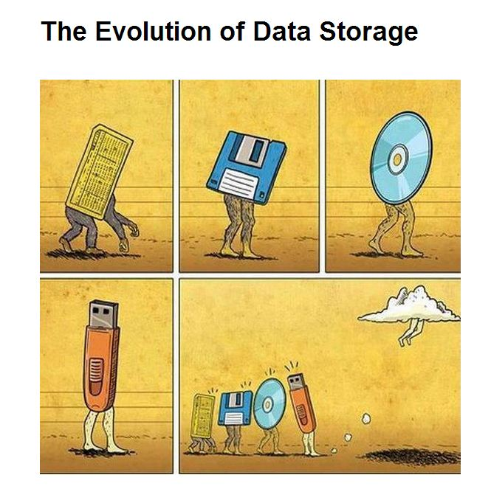
The End

